Slide 1


DeepNutriScan: Real-Time Detection and Nutritional Analysis of Diverse Food Items via Machine Learning.
Supervisor : DR. MD. ASRAF ALI

Slide 2

Problem Background
Inaccessibility of Accurate Information
Many individuals struggle to access reliable nutritional information, resulting in poor dietary choices. Existing resources often lack accuracy, are difficult to understand, or are not readily available, exacerbating public health issues and hindering informed eating decisions.
Time-Consuming Manual Processes
Manual nutritional analysis is often time-consuming, requiring extensive laboratory testing and expert knowledge. This approach delays dietary assessments, complicates meal planning, and inhibits timely health decisions, highlighting the need for more efficient, real-time solutions like DeepNutriScan.

Slide 3
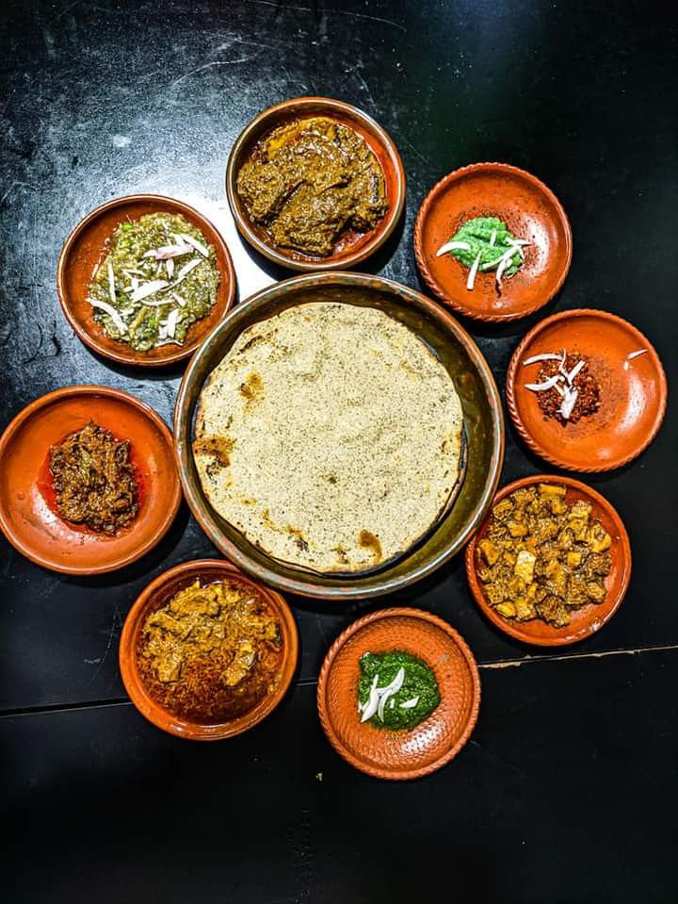
Variability in Food Composition
Variability in food composition poses significant challenges in nutritional analysis. Factors such as agricultural practices, processing methods, and storage conditions can alter nutrient levels, leading to inconsistencies. Accurate detection and analysis require advanced machine learning techniques to account for this variability and improve dietary assessments.
Poor Integration with Existing Systems
Existing food analysis systems often lack seamless integration with modern technologies, leading to fragmented data management and inefficient workflows. This hinders the real-time capabilities of DeepNutriScan, preventing users from accessing comprehensive nutritional insights easily and impeding informed dietary choices.

Slide 4
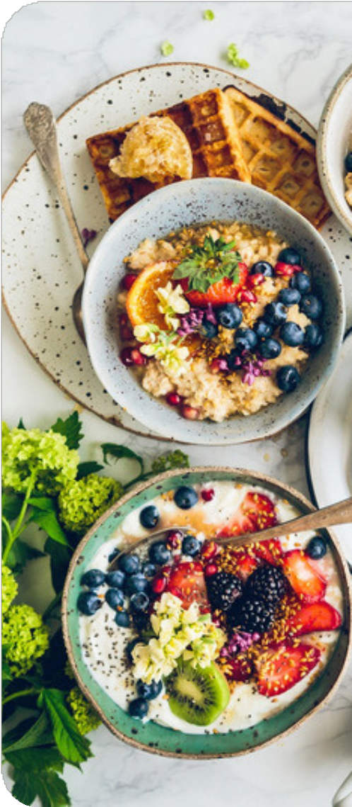

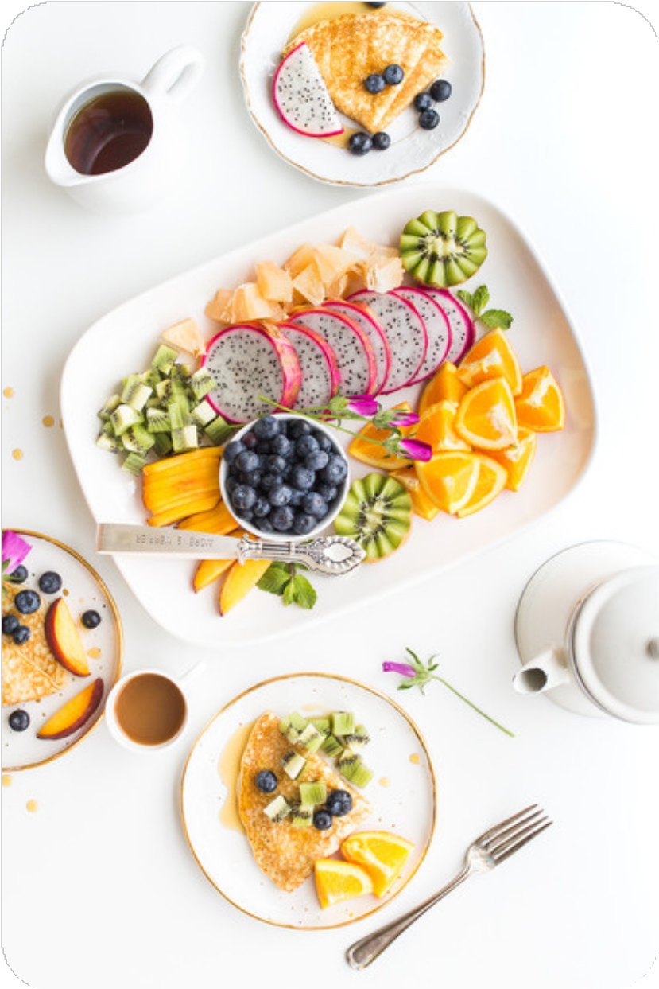

Motivation
Impact on Public Health
Nutritional knowledge is crucial for improving public health outcomes. By enabling real-time food analysis, DeepNutriScan empowers individuals to make informed dietary choices, potentially reducing obesity rates and chronic diseases while promoting overall well-being within communities.
Role in Preventive Healthcare
Understanding nutritional knowledge is vital for preventive healthcare, as it empowers individuals to make informed dietary choices, reducing the risk of chronic diseases. DeepNutriScan leverages machine learning to enhance this knowledge, facilitating real-time analysis that promotes healthier eating habits and proactive health management.

Slide 5



Objective
Diverse Food Coverage
Ensure the ability to analyze a wide variety of food types, from whole foods to processed items.
2
Real-Time Analysis
Develop a system capable of analyzing food items in real-time to provide immediate nutritional feedback.
1
User-Friendly Interface
3
Create an easy-to-use interface accessible via smartphones or web applications to facilitate regular use by all demographics.

Slide 6



Methodology
The methodology involves three key steps: data collection, model development using CNNs, and a user feedback loop to refine the model for better performance.
1
2
3
Data Collection
Model Development
User Feedback Loop
Gather a comprehensive dataset of food items paired with their nutritional information for training the machine learning model.
Utilize machine learning algorithms such as convolutional neural networks (CNNs) to classify food items and predict their nutritional content based on images.
Implement a system for users to provide feedback on analysis accuracy, refining the model over time for enhanced performance.

Slide 7





DeepNutriScan Model Results
90%
5 s
High Satisfaction
Model Accuracy
Speed of Analysis
User Engagement
Initial tests indicate that the DeepNutriScan model achieves over 90% accuracy in food classification, showcasing its reliability.
The platform can process images and deliver nutritional information in under five seconds, making it highly efficient for real-time use.
Early user trials demonstrate a high level of satisfaction with the application, highlighting improvements in dietary awareness and monitoring habits.

Slide 8



Machine Learning in Food Analysis
Technical Sources
The system uses smart computer techniques like CNNs, which help it recognize food in pictures. These technologies are the base of tools like DeepNutriScan, which can find food items and give nutrition details.
Literature Review
2
Many studies and research papers say that machine learning is very helpful in checking food items. It can tell us what kind of food we are eating and help us manage our diet better.
1
User Studies
3
People who use this kind of system give useful feedback. Their opinions help make the system better — more accurate and easier to use.

Slide 9



Conclusion
Impact on Nutritional Awareness
Future Enhancements
Call to Action
Ongoing development aims to expand food item coverage, incorporate regional foods, and integrate personalized dietary recommendations based on user preferences.
Encouraging collaboration with nutritionists and tech developers for continuous improvement and widespread implementation of the technology.
DeepNutriScan has the potential to revolutionize the way individuals engage with their food habits, promoting better health outcomes.

Slide 10
Reference
[1] P. Pouladzadeh, S. Shirmohammadi, and R. Al-Maghrabi, "Measuring calorie and nutrition from food images," IEEE Transactions on Instrumentation and Measurement, vol. 63, pp. 34–40, 2014.
[2] R. Yunus et al., "A framework to estimate the nutritional value of food in real-time using machine learning techniques," IEEE Access, vol. 7, pp. 2643–2653, 2019.
[3] J. Sultana et al., "A study on food value estimation from images: Taxonomies, datasets, and techniques," IEEE Access, vol. 4, pp. 1–10, 2023.
[4] M. Al-Saffar and W. Baiee, "Nutrition information estimation from food photos using machine learning based on multiple datasets," Bulletin of Electrical Engineering and Informatics, vol. 11, no. 5, pp. 2922–2929, 2022.
[5] A. Ahsan Jeny et al., "FoNet - Local food recognition using machine learning-based residual neural networks," in International Conference on Information Technology (ICIT), 2019.
[6] A. Uddin et al., "Traditional Bengali food classification using machine learning models," in Proceedings of the 2021 International Conference on Artificial Intelligence and Data Science, pp. 1–9, 2021.
[7] S.-J. Park et al., "The development of food image detection and recognition model of Korean food for mobile dietary management," Nutrition Research and Practice, vol. 13, no. 6, pp. 521–528, 2019.
[8] S.-J. Park et al., "The development of food image detection and recognition model of Korean food for mobile dietary management," Nutrition Research and Practice, vol. 13, no. 6, pp. 521–528, 2019.
[9] B. D., "Food detection using YOLOv5 model for real-time identification," BD Food Detection using YOLOv5, 2022.
[10] M. Appana, "Feast for the Eyes: Multiple Food Component Detection for Nutrition Estimation," M.S. project, Dept. of Computer Science, California State University, Sacramento, CA, USA, 2024.
[11] Bahadur, S., Kushwaha, R., Sharma, S., & Anuradha, S. G. Using deep learning techniques, a framework for estimating the nutritional value of food in real time. International Journal of Health Sciences, 6(S2), 7635–7648, 2022.
[12] S. Abuowaida, E. Elsoud, A. Al-Momani, M. Arabiat, H. A. Owida, N. Alshdaifat, and H. Y. Chan, "Proposed enhanced feature extraction for multi-food detection method," Journal of Theoretical and Applied Information Technology, vol. 101, no. 24, pp. 3710–3720, Dec. 2023
[13] D. Gomes, "Classification of Food Objects Using Deep Convolutional Neural Network Using Transfer Learning," International Journal of Education and Management Engineering (IJEME), vol. 14, no. 2, pp. 53–60, Apr. 2024.
[14] J.-T. Huang and C.-H. Wang, "Deep Learning-Based Food Identification and Calorie Estimation System," in Proc. 7th Int. Conf. Applications and Systems of Visual Paradigms (VISUAL 2022), Venice, Italy, pp. 1–6, May 2022.
[15] T. Ghosh and E. Sazonov, "Improving Food Image Recognition with Noisy Vision Transformer," arXiv preprint arXiv:2503.18997, Mar. 2025.
[16] Y. Zhao, P. Zhu, Y. Jiang, and K. Xia, "Visual nutrition analysis: leveraging segmentation and regression for food nutrient estimation," Frontiers in Nutrition, vol. 11, Art. no. 1469878, Dec. 2024.
[17] W. Min, X. Hong, and Y. Rui, "Multimodal Food Learning," ACM Computing Surveys, vol. 57, no. 2, pp. 1–36, Feb. 2025.
[18] A. Sharma and C. Kumar, "Analysis & Numerical Simulation of Indian Food Image Classification Using Convolutional Neural Network," Int. J. New Pract. Manag. Eng., vol. 12, no. 1, pp. 56–70, Mar. 2023.

Slide 11
Citation
P. Pouladzadeh, S. Shirmohammadi, and R. Al-Maghrabi, "Measuring calorie and nutrition from food images," IEEE Transactions on Instrumentation and Measurement, vol. 63, pp. 34–40, 2014.
R. Yunus et al., "A framework to estimate the nutritional value of food in real-time using machine learning techniques," IEEE Access, vol. 7, pp. 2643–2653, 2019.
J. Sultana et al., "A study on food value estimation from images: Taxonomies, datasets, and techniques," IEEE Access, vol. 4, pp. 1–10, 2023.
M. Al-Saffar and W. Baiee, "Nutrition information estimation from food photos using machine learning based on multiple datasets," Bulletin of Electrical Engineering and Informatics, vol. 11, no. 5, pp. 2922–2929, 2022.
A. Ahsan Jeny et al., "FoNet - Local food recognition using machine learning-based residual neural networks," in International Conference on Information Technology (ICIT), 2019.
A. Uddin et al., "Traditional Bengali food classification using machine learning models," in Proc. 2021 Int. Conf. on Artificial Intelligence and Data Science, pp. 1–9, 2021.
S.-J. Park et al., "The development of food image detection and recognition model of Korean food for mobile dietary management," Nutrition Research and Practice, vol. 13, no. 6, pp. 521–528, 2019.
M. Appana, "Feast for the Eyes: Multiple Food Component Detection for Nutrition Estimation," M.S. project, Dept. of Computer Science, California State University, Sacramento, CA, USA, 2024.
D. Gomes, "Classification of Food Objects Using Deep Convolutional Neural Network Using Transfer Learning," Int. J. Education and Management Engineering (IJEME), vol. 14, no. 2, pp. 53–60, Apr. 2024.
Y. Zhao, P. Zhu, Y. Jiang, and K. Xia, "Visual nutrition analysis: leveraging segmentation and regression for food nutrient estimation," Frontiers in Nutrition, vol. 11, Art. no. 1469878, Dec. 2024.

Slide 12


Slide 13


Q/A

